Slide 1
Java script Core

Slide 2
Who Am I?
Name: Adrian Zghibarta
2 Years – iOS development
2 Years – React Native development

Slide 3
Question – What Am I doing here?

Slide 4
JS – Universal Language

Slide 5

React native React JS

Slide 6

DO You Know JS? – Usual answer

Slide 7

Let me tell YA - YOU Don't KNOW JS!

Slide 8
really – there is such book

Slide 9
What is JS and how to run it
JS is:
Scripting Programming Language
JS code is almost totally interpreted
Dynamic Typed
Run JS:
Directly in Chrome (or another browser)
Compiling it using Node JS

Slide 10
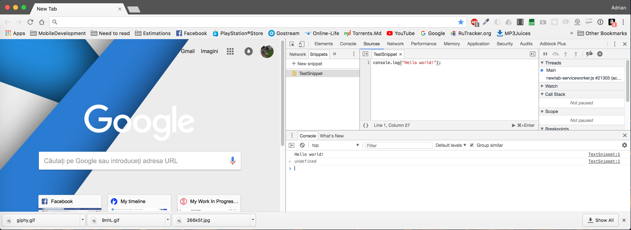
Run JS in Chrome

Slide 11
Run JS with NODE JS
Install NodeJS on your computer
Install some IDE (or a good text editor) on your computer, for this class I will use Visual Studio Code
Create your file_name.js, edit it and run it with command node file_name.js in terminal
For more friendly usage you can download this repo
It contains a Node JS test environment with Chokidar setup that automatically run JS file on save.

Slide 12
Right into JS

Slide 13
The plan
Introduction and basic syntax
Scope and Closures
this (only this ☺)
Object Prototypes
Types and Values
Coertion and Grammar
Async
ES6

Slide 14
Values and types

Slide 15
JS data Types
Six data types that are primitives:
Boolean
Null
Undefined
Number
String
Symbol (new in ECMAScript 6)
and Object

Slide 16
Operators?

Slide 17
Operators
Assignment : someVariable = 2
Math : +, -, /, *
Compound assignment : +=, *= …
Increment/decrement : someNumber++, --otherNumber
Object property access : someObject.someProperty
Equality : ==, ===, !=, !==
Comparison : <, >, <=, >=
Logical : &&, ||

Slide 18
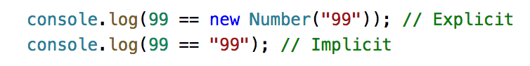
Type Coercion (implicit and Explicit)

Slide 19

Type coercion – My first reaction

Slide 21
Is this right?

Slide 22
Simple but important stuff
Variables (and also constants)
Blocks
Conditionals
Loops
Functions
Scope

Slide 23
In JavaScript, each function gets its own scope. Scope is basically a collection of variables as well as the rules for how those variables are accessed by name.

Slide 24
General Compile Theory (var a = 2)
Tokenization - Divide
Parsing – Construct (Abstract Syntax Tree)
Code generation – Machine talking

Slide 25
JS compile theory (var a = 2)
Engine
Compiler
Scope

Slide 26
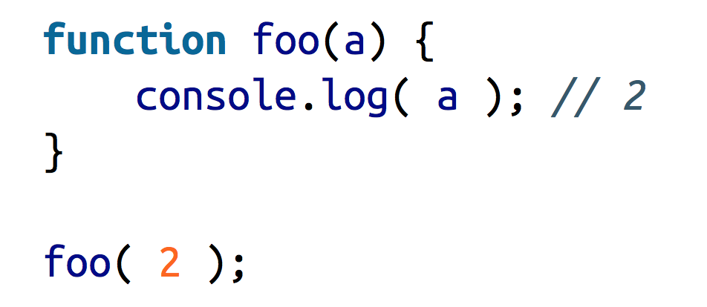
Engine’s LHS / RHS

Slide 27
Engine errors

Slide 28
More about errors
TypeError - Creates an instance representing an error that occurs when a variable or parameter is not of a valid type.
ReferenceError - Creates an instance representing an error that occurs when de-referencing an invalid reference.
InternalError - Creates an instance representing an error that occurs when an internal error in the JavaScript engine is thrown. E.g. "too much recursion".
RangeError - Creates an instance representing an error that occurs when a numeric variable or parameter is outside of its valid range.
SyntaxError - Creates an instance representing a syntax error that occurs while parsing code in eval().
URIError - Creates an instance representing an error that occurs when encodeURI() or decodeURI() are passed invalid parameters.
EvalError - Creates an instance representing an error that occurs regarding the global function eval().

Slide 29
Scope ...?

Slide 30
Nested Scopes and shadowing

Slide 31
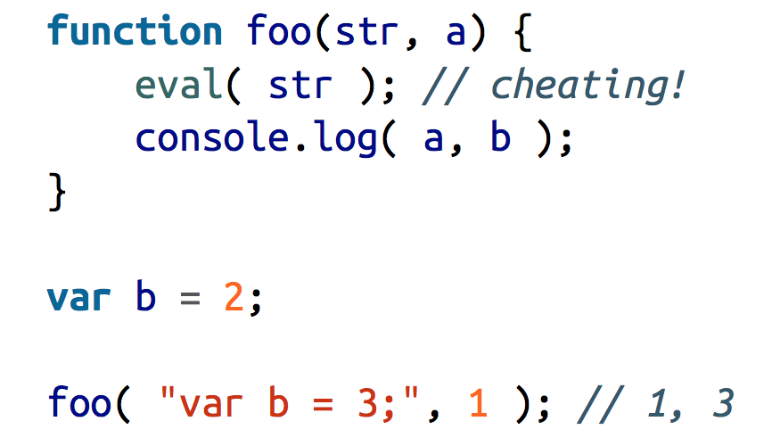
Cheating Lexical Scope With eval

Slide 32
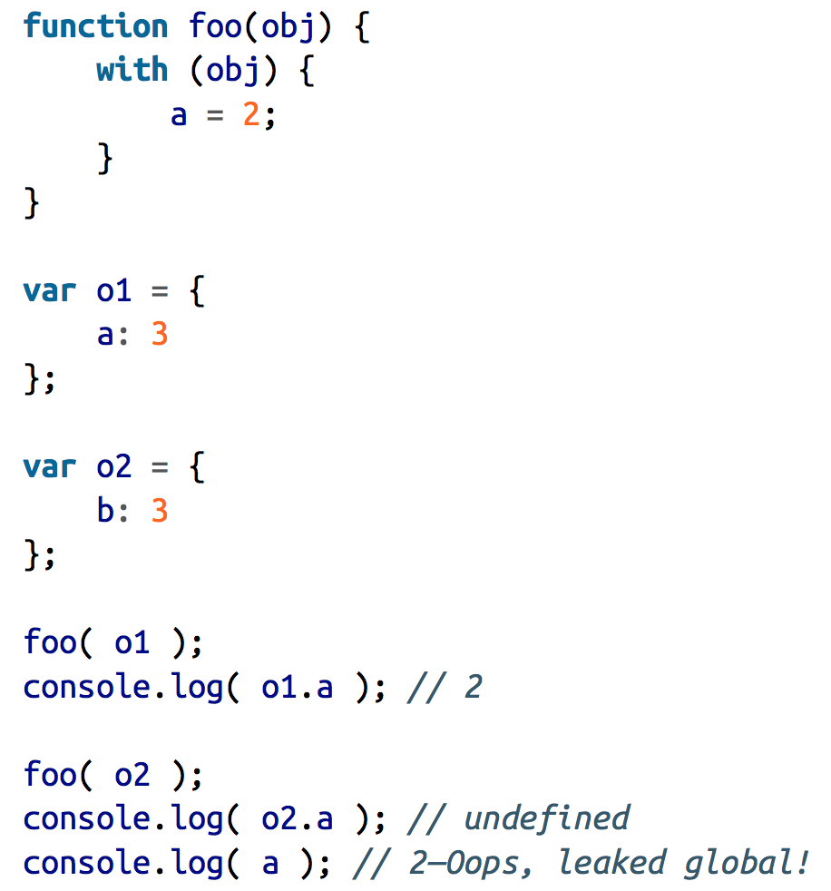
Cheating Lexical Scope With ‘WITH’

Slide 33
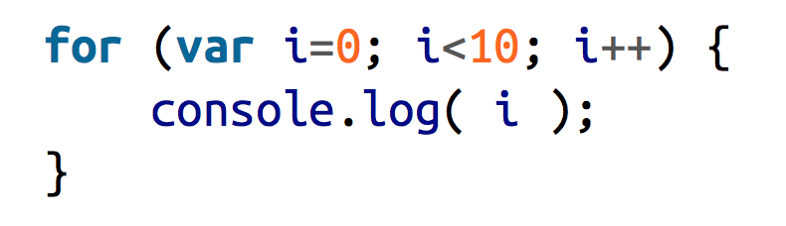
Blocks / Lexical scope
What’s wrong with this:

Slide 34
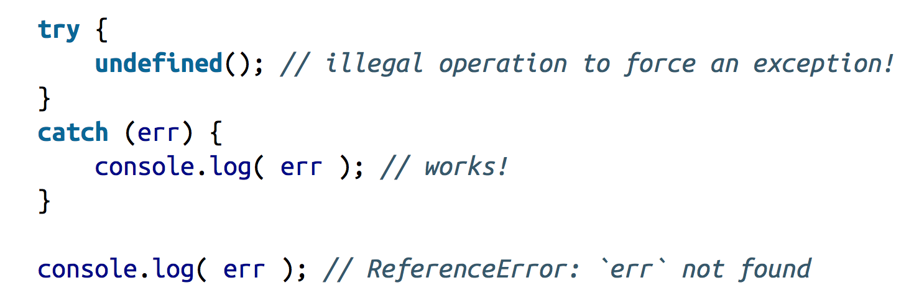
Try / catch – first block scoped

Slide 35
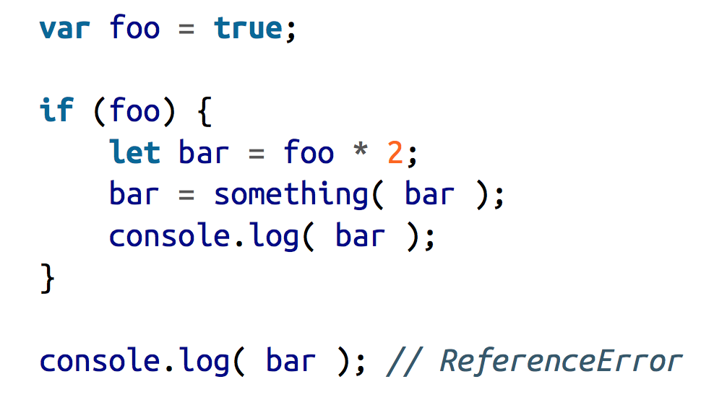
LET – ES6 Solution for block scope

Slide 36
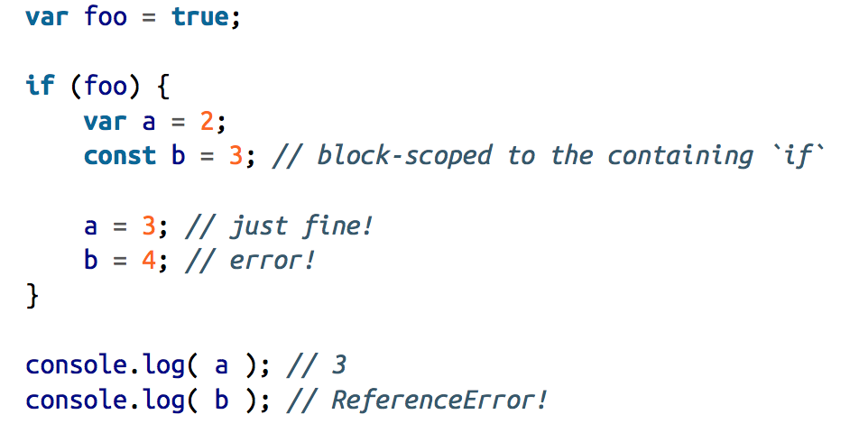
Even more with const

Slide 37
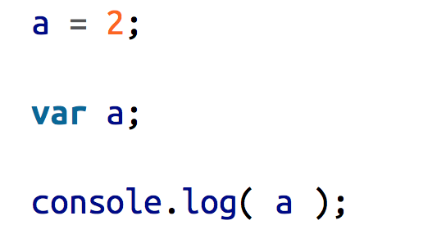
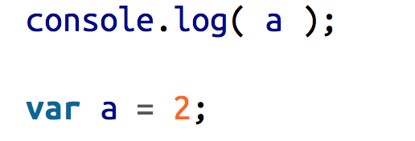
Hoisting

Slide 38

Hoisting
// prints undefined
// prints 2

Slide 39
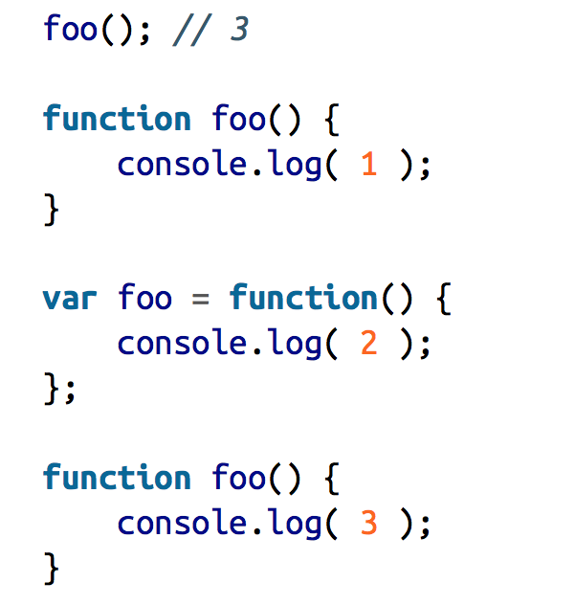
Hoisting order

Slide 40
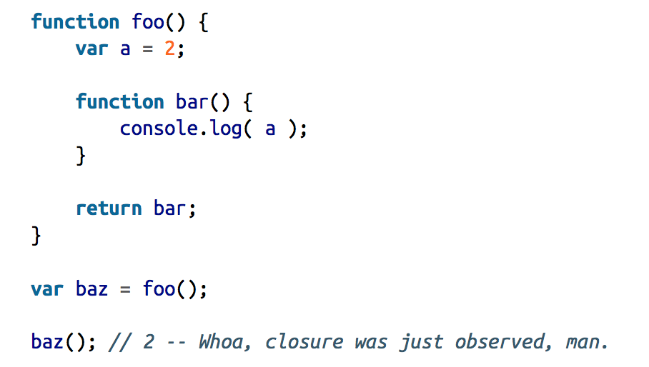
Closure
Closure is when a function is able to remember and access its lexical scope even when that function is executing outside its lexical scope.

Slide 41
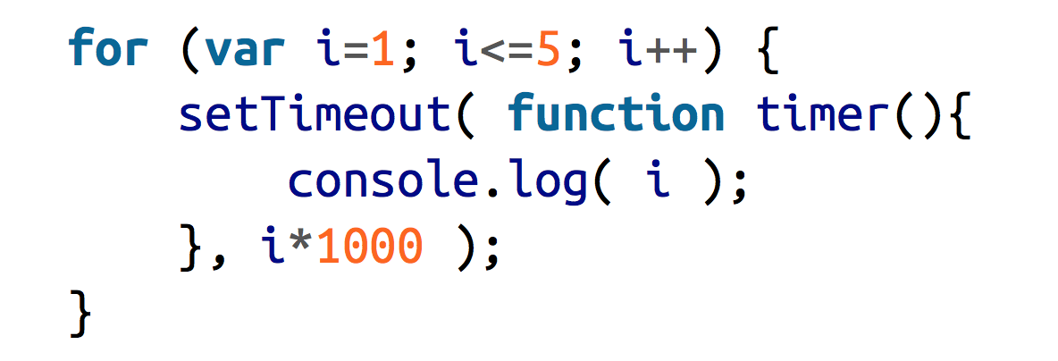
What will be printed?

Slide 42
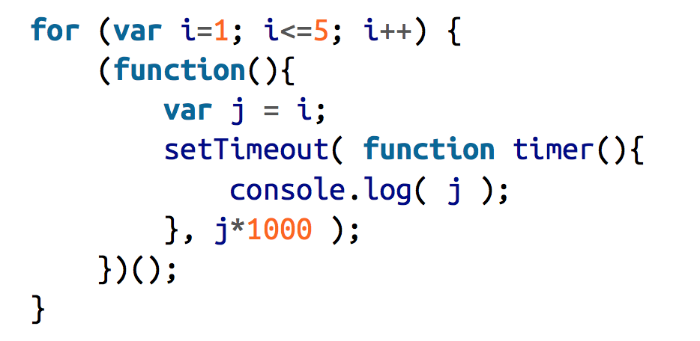
And now? (IIFE)

Slide 43
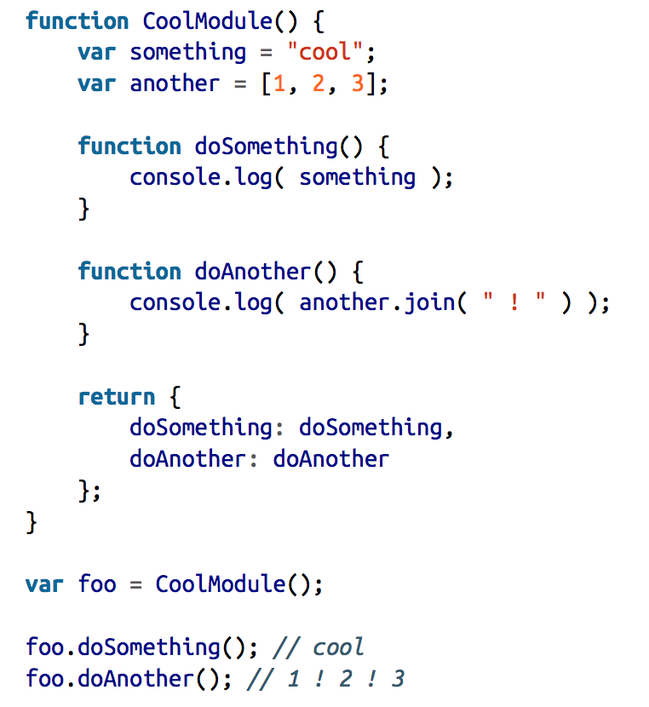
Module pattern

Slide 44
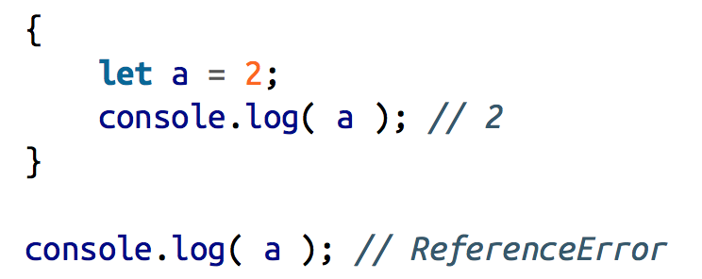
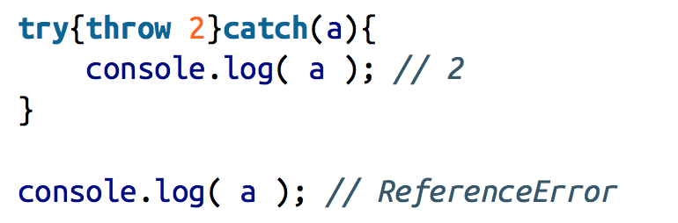
Polyfilling and transpiling
ES6
Pre ES6 (transpiled)

